Slide 1






AL BARAKA
Supervisor:
Dr. Rami Sfarjalani
Presented by:
“IF YOU’RE THROWING AWAY FOOD,YOU’RE THROWING AWAY LIFE”
ROUBA AYACH
AL BARAKA
01

Slide 2
Contents
1.
2.
3.
Introduction
Our Goals
Solving Problem
4.
5.
6.
Implementation
Future Work
Conclusion
www.albaraka.com
02

Slide 3
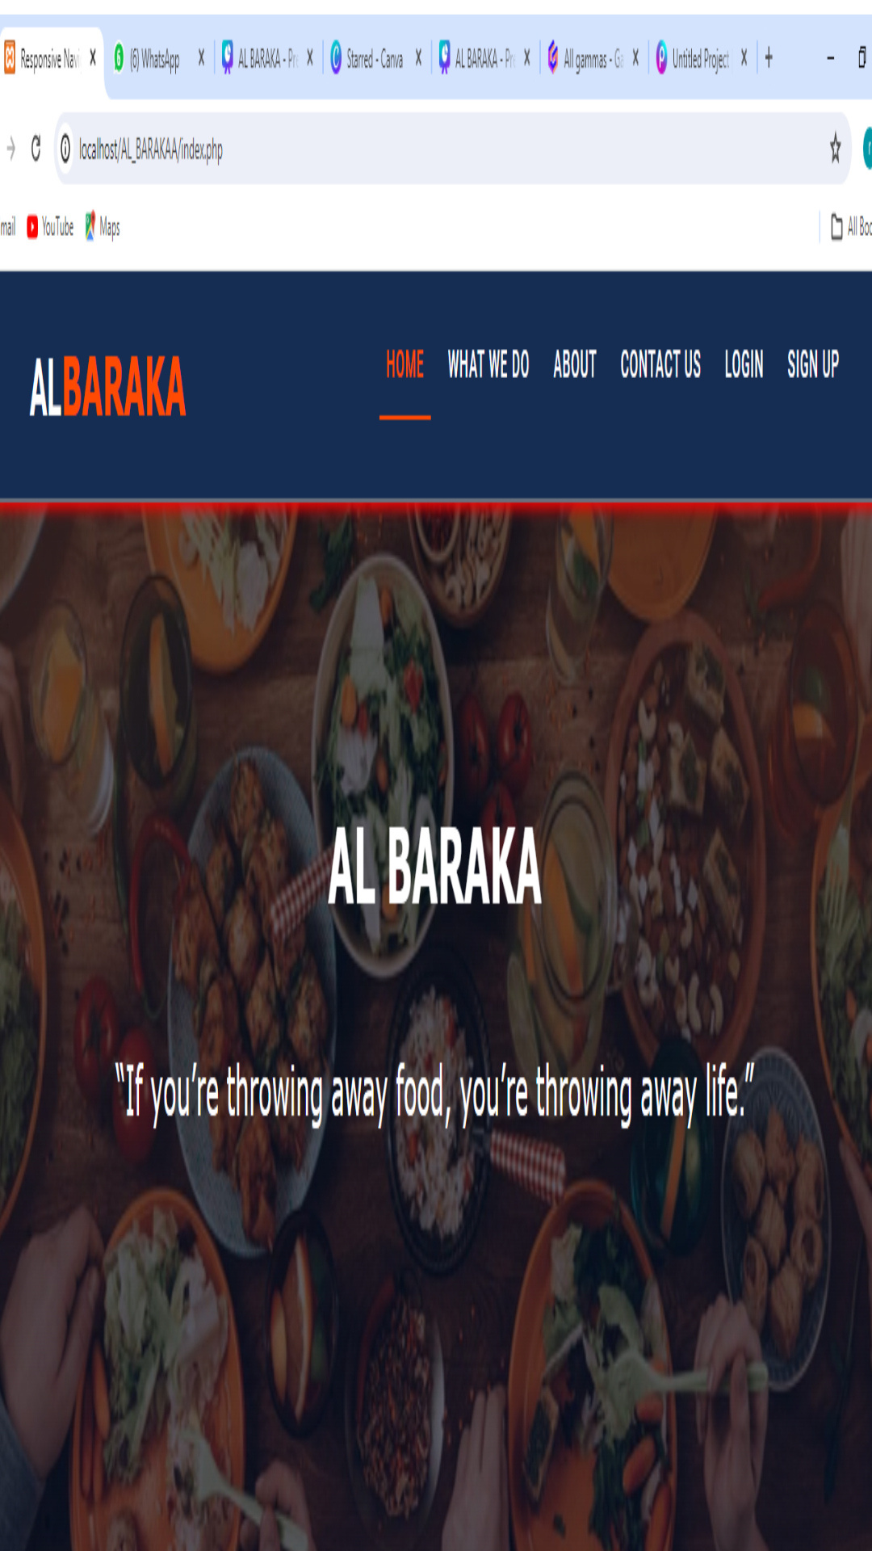
Introduction
In a world where food waste and hunger coexist, my project stands as a beacon of hope.
Our project tackles the critical issue of food waste by repurposing surplus food from events and redirecting it to those need.
03

Slide 4


GOALS 01
Minimizing food waste.
GOALS 02
Increasing accessibility to nutritious food for those in need.
Our
Goals
GOALS 03
Foster culture of community through volunteerism.
www.albaraka.com 04

Slide 5
Solving Problem
Distribution Food between Association
Nb of Times for
Receiving Food
Delivery Food
Type
% of Need
Food Kind
Event Status
Always(%>60)
One(after 5 days)
Volunteering
Work
www.albaraka.com 05

Slide 6

To build the website we use:
1.
2.
HTML
CSS
3.
4.
AJAX
PHP
Hosting
www.albaraka.com
06

Slide 7


Slide 8



Slide 9
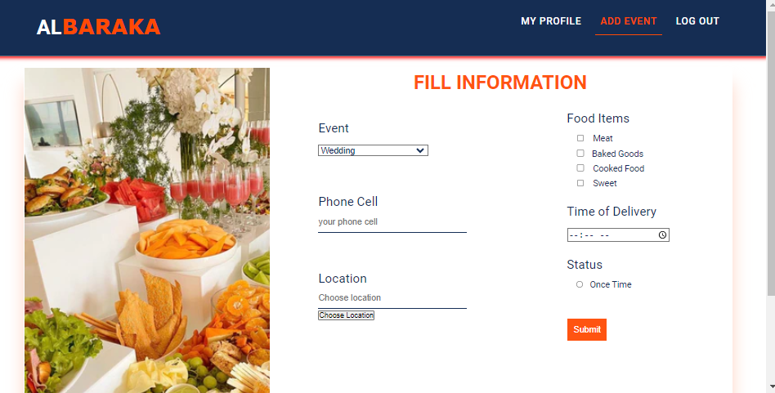

Slide 10
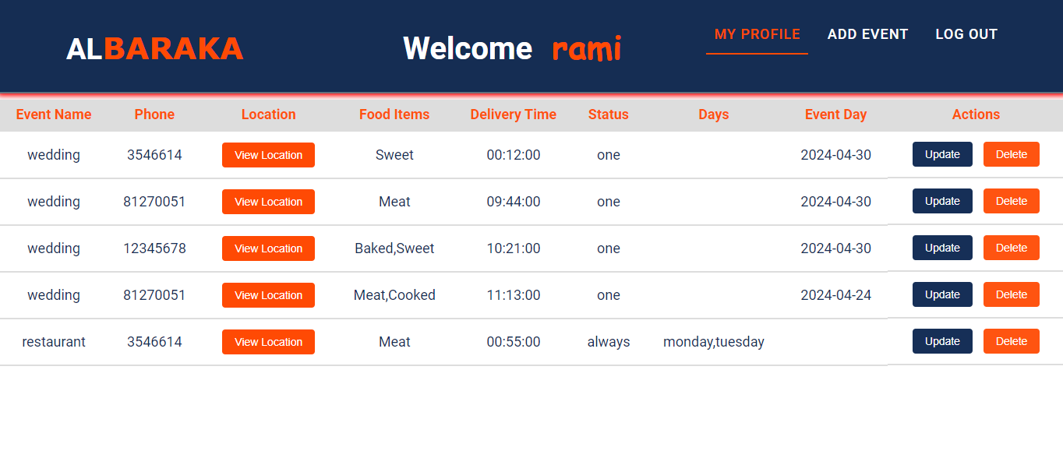

Slide 11
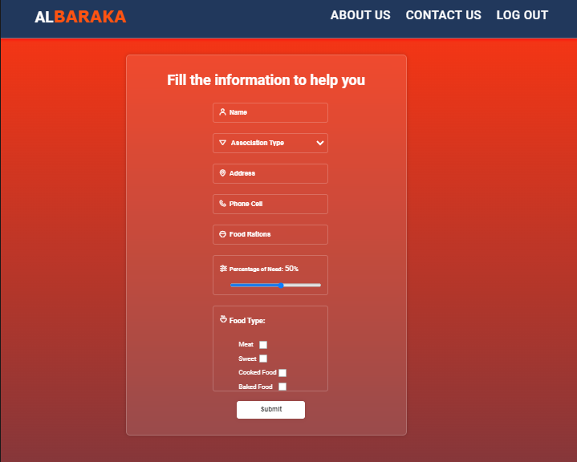

Slide 12
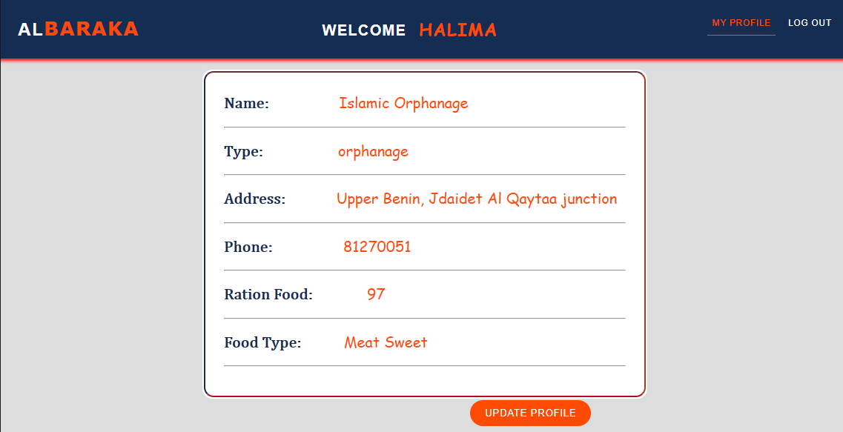

Slide 13
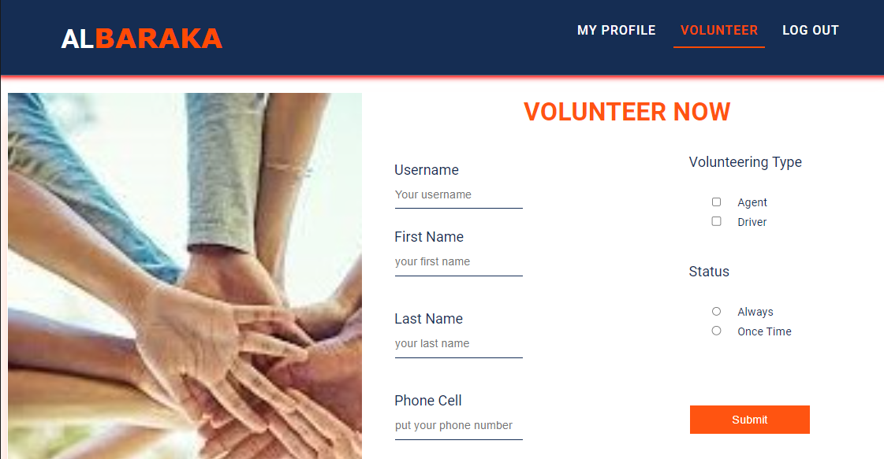

Slide 14
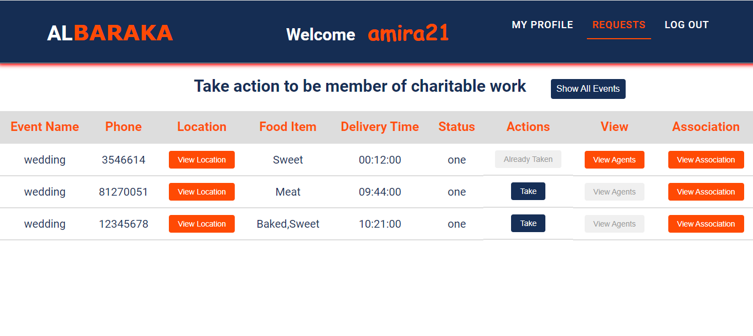

Slide 15
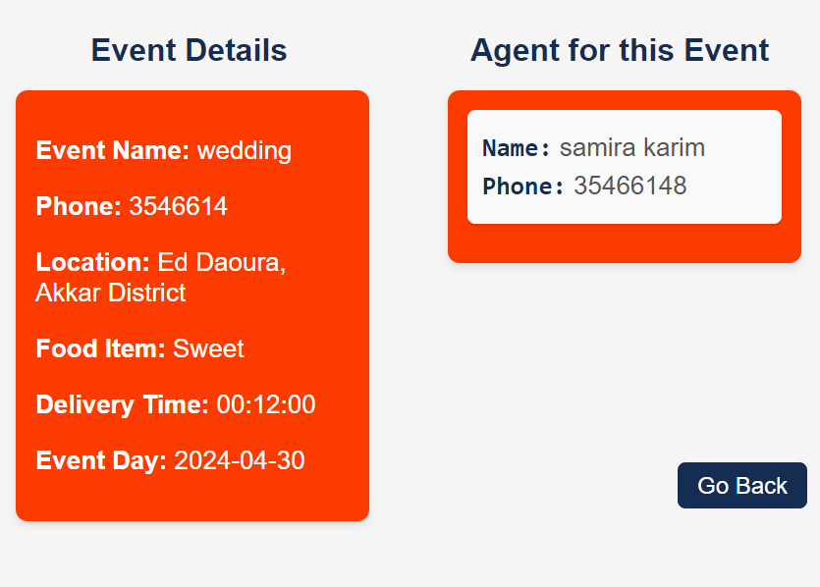
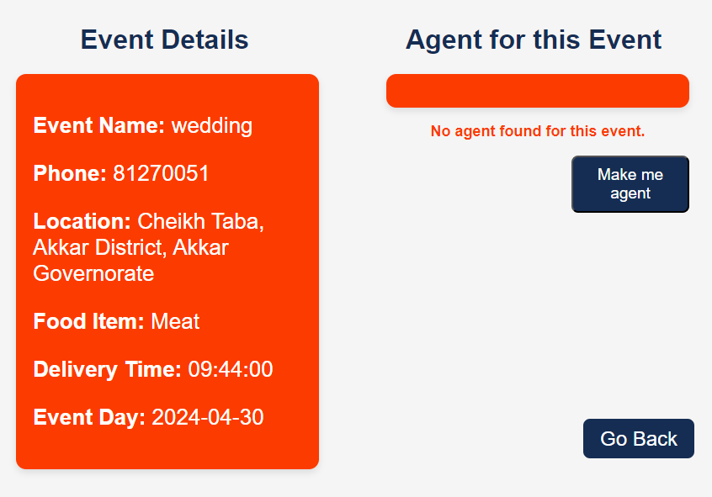

Slide 16
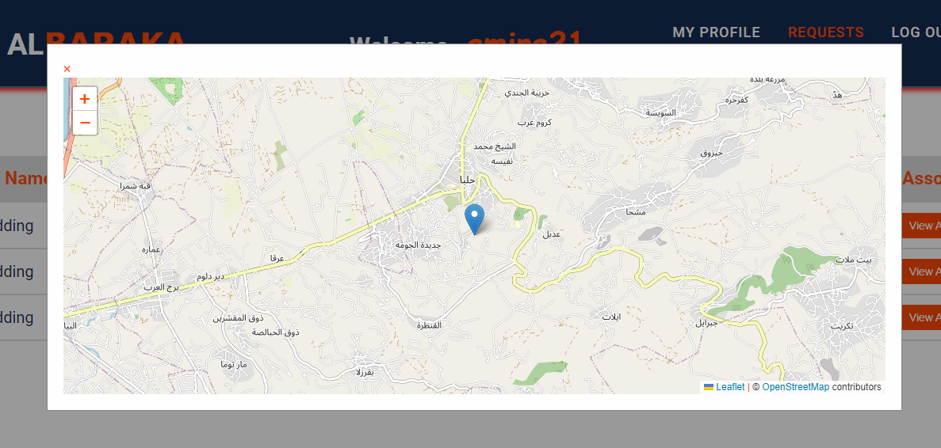

Slide 17
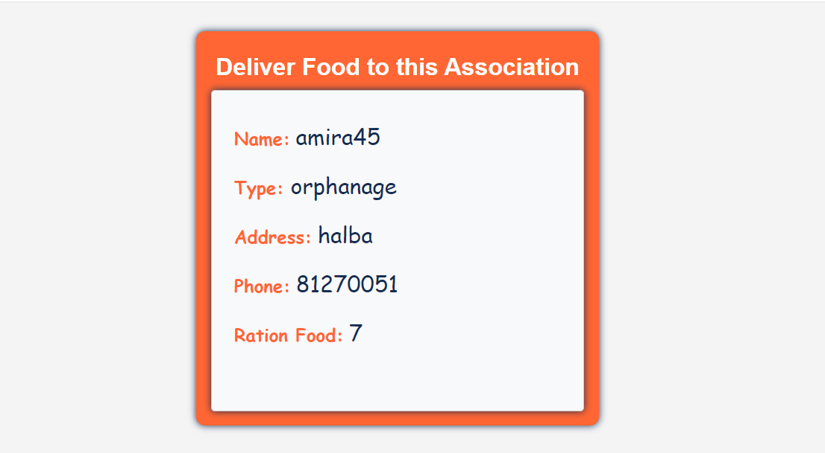

Slide 18
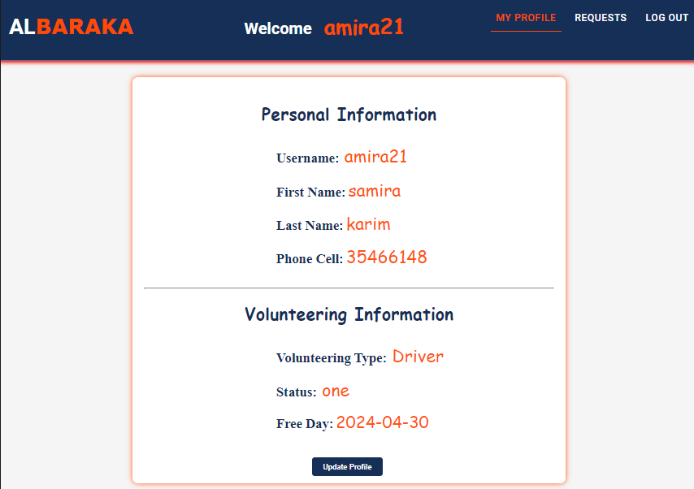

Slide 19
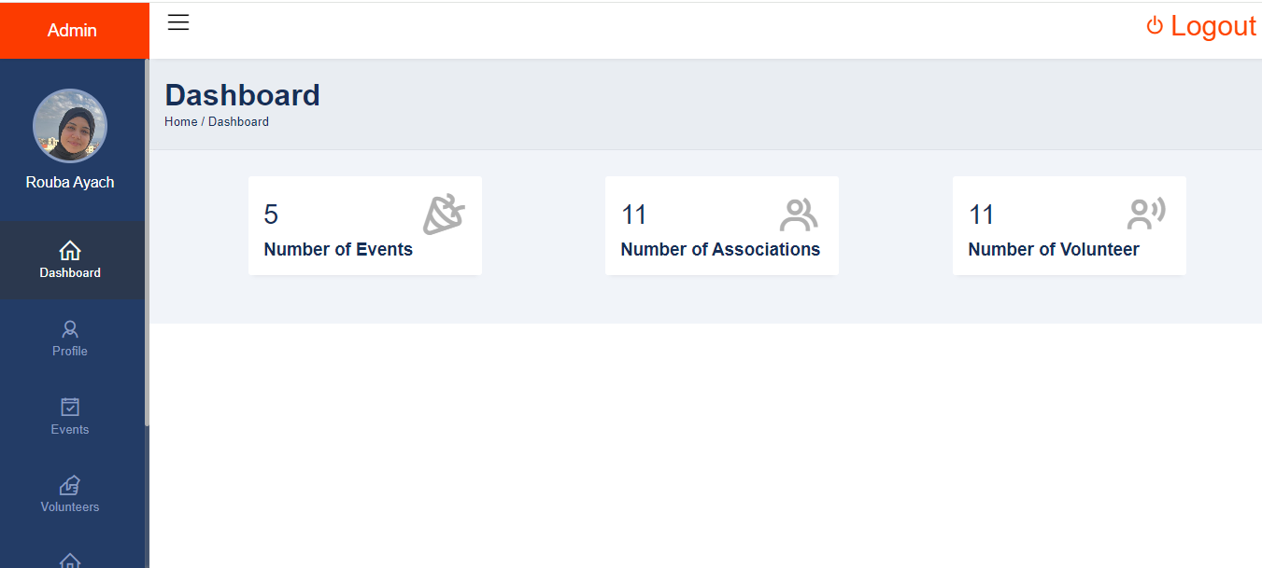

Slide 20


Contact Us
81/254271
support@albaraka.com
www.albaraka.com
www.albaraka.com
07

Slide 21
Future Work
1
2
3
Plan One
Plan Two
Plan Three
Expansion to Global Scale
Inclusion poor
areas and homeless populations
Establishing surplus food distribution points
www.albaraka.com
08

Slide 22
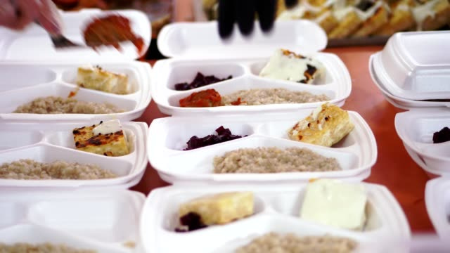
AL BARAKA
Conclusion
Say ‘Yes’ to Sharing
‘No’ to Wasting
AL BARAKA is platform to redistribute excess food from event to associations serving those in need.
Through volunteer-driven efforts surplus food is efficiently collected and delivered, reducing waste and combating food insecurity.
By leveraging technology and community involvement, AL BARAKA offers a practical solution to promote sustainability and social impact in our food system.
www.albaraka.com 09

Slide 23
I would like to express my appreciation to:
Dr. Rami Sfarjalani who have supported and guided me throughout this journey, your expertise and encouragement have been invaluable.
My family who supported me.
THANK YOU
www.albaraka.com 10

